Slide 1
PC613: Communication Skills
Sem I, MSc IT
Instructor: Dr. Jenson Joseph

Slide 2
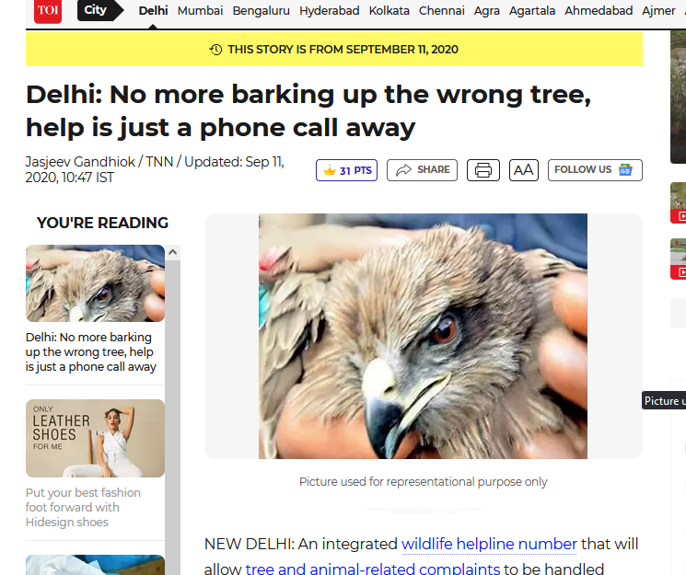
Learn an idiom
“to bark up the wrong tree”

Slide 3
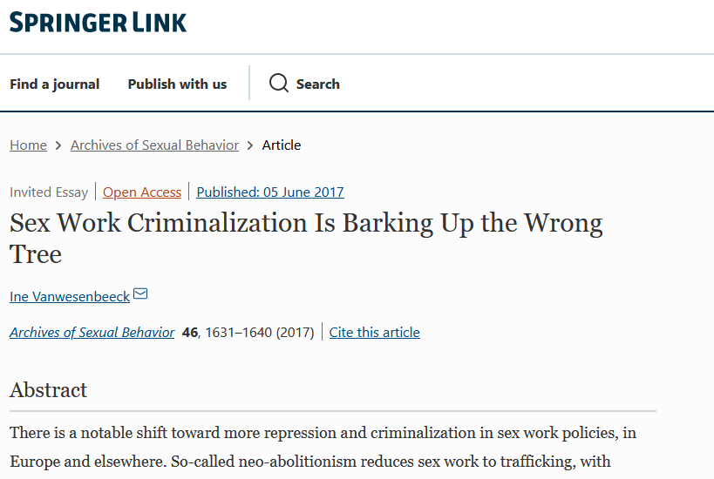
Learn an idiom
“to bark up the wrong tree”

Slide 4
Learn an idiom
“to bark up the wrong tree” means to be wrong about the way to achieve something.
-- To attempt or pursue a futile course of action.
-- to promote or follow a mistaken course (as in doing research).
Examples:
She thinks it'll solve the problem, but I think she's barking up the wrong tree.
If you think I'll help you cheat, you're definitely barking up the wrong tree!
If you think I'm the guilty person, you're barking up the wrong tree.
The management blamed our team for the company’s bad performance, but it is barking up the wrong tree.

Slide 5
At, on and in (while referring to place)
Prepositions: AT
to refer to a position or location which we see as a point/place:
I was sitting at my desk.
You can pay at the counter.
They met at the airport.
to talk about companies, workplaces (when we see them as a place of activity):
How many people are working at Microsoft?
What are the developers working on currently at Intel?
to refer to activities which involve a group of people:
Were you at Lisa’s party? (also at the cinema, at the theatre)

Slide 6
At, on and in
Prepositions: AT
with school/college/university:
She always did well at school.
They met at college and became friends instantly.
Do you know how Facebook recommends friends I’ve met at school?
to refer to an address:
They once lived at number 12 South George’s Street.
to refer to most shops:
Look what I bought at the butcher’s today.
I saw a nice watch at a showroom near the railway station, but it was too expensive.

Slide 7
At, on and in
Prepositions: ON
We use ‘on’
to refer to a position on any surface:
I know I left my wallet on the table.
to describe a position along a road or river or by the sea or by a lake:
Dublin is on the east coast of Ireland.
Ahmedabad is on the banks of the river Sabarmati.
to talk about a floor in a building:
They live on the first floor.
to talk about being physically on public transport:
I was on the train when she phoned. (but “I went to Rome by train”.)

Slide 8
At, on and in
Prepositions: IN
We use ‘in’:
to talk about locations within a larger area:
I know my book is somewhere in this room. Can anyone see it?
to talk about workplaces when we see them as a physical location:
She sits in a big office room. (but we use on when we talk about a farm: I’ve always wanted to work on a farm.)
With ‘class’:
He found it difficult to concentrate in class.

Slide 9
At, on and in (while referring to time)
Prepositions: AT
We use at:
with particular points on the clock::
I’ll see you at five o’clock.
with particular points in the week:
What are you doing at the weekend? (but, what are you doing on Saturday/Monday…).
with special celebrations:
At the New Year, millions of people travel home to be with their families (but we say on your birthday).
Note: We don’t use at with the question What time …? in informal situations:
What time are you leaving? (preferred to At what time are you leaving?)

Slide 10
At, on and in (while referring to time)
Prepositions: ON
We use on:
with dates, and special dates
We moved into this house on 25 October 1997.
I was born on 7 Feb …
What do you normally do on your birthday? (special date)
with a singular day of the week:
I’ve got to go to London on Friday.
The office is closed on Saturdays. (It is ok to ask informally, “do you work Saturdays?” by omitting ‘on’)

Slide 11
At, on and in (while referring to time)
Prepositions: IN
We use in:
with parts of the day: I’ll come and see you in the morning for a cup of coffee, okay?
with months: We usually go camping in July or August.
with years: The house was built in 1835.
with seasons, and long periods in time:
The garden is wonderful in the spring when all the flowers come out.
The population of Europe doubled in the nineteenth century.
They take a vacation in summer.

Slide 12
Exercises
in, on, at, or to.
She was born _____ Ahmedabad.
I am going _____ the dentist _____ 9:00 a.m.
Theo's birthday is _____ September 7th.
Gandhinagar is _____ the state of Gujarat.
_____ Saturdays, they often meet friends _____ a restaurant.
_____ night, they sometimes go _____ a disco.
_____ weekends, she likes driving _____ her friend's house.
She usually arrives _____ the morning _____ 8 o'clock.
I was still _____ campus when it happened.
Let’s have lunch _____ Mocha today.

Slide 13
Exercises
in, on, at, or to.
She was born _in____ Ahmedabad.
I am going _to____ the dentist __at___ 9:00 a.m.
Theo's birthday is _on____ September 7th.
Gandhinagar is _in__ the state of Gujarat.
__On_ Saturdays, they often meet friends _at____ a restaurant.
__At___ night, they sometimes go _to____ a disco.
_At____ weekends, she likes driving _to____ her friend's house.
She usually arrives __in___ the morning _at__ 8 o'clock.
I was still _on__ campus when it happened.
Let’s have lunch _at____ Mocha today.

Slide 14
Exercises
in, on, at, or to.
My house is the blue one at the end of the road.
The protest is at the corner of those two streets.

Slide 15
Exercises
At or On?
Note: We use at to talk about public holidays and weekends, but when we talk about a particular special day or weekend, we use on.
We never go away --- the New Year because the traffic is awful.
--- New Year’s Day, the whole family gets together.
I’ll go and see my mother --- the weekend if the weather’s okay.
What do you usually do --- the weekend? Do you go away?
The folk festival is always held --- the last weekend in July.
(Exception to the rule): I’m so looking forward to going home --- Diwali.

Slide 16
Exercises
At or On?
Note: We use at to talk about public holidays and weekends, but when we talk about a particular special day or weekend, we use on.
We never go away -at-- the New Year because the traffic is awful.
-On-- New Year’s Day, the whole family gets together. (Because we are talking about the day, not the occasion of the New Year)
I’ll go and see my mother -at-- the weekend if the weather’s okay. (weekend as an occasion)
What do you usually do -at-- the weekend? Do you go away? (indicates habit; no particularity to the weekend mentioned here)
The folk festival is always held -on-- the last weekend in July. (particular weekend)
(Exception to the rule): I’m so looking forward to going home –on/during-- Diwali.

Slide 17
Exercises
In or On?
Note: We use in with morning, afternoon, evening and night, but we use on when we talk about a specific morning, afternoon, etc., or when we describe the part of the day.
I always work best --- the morning. I often get tired --- the afternoon..
The ship left the harbour --- the morning of the ninth of November.
--- the evening they used to sit outside and watch the sun going down.
It happened --- a beautiful summer’s evening.
Note: In the night usually refers to one particular night; at night refers to any night in general:
I was awake in the night, thinking about all the things that have happened.
‘It’s not safe to travel at night,’ the officer said. I stayed awake in the night thinking about how to return.
In the night I was not able to get any sleep (talking about one particular night); I don’t get sleep at night (general)

Slide 18
Exercises
In or On?
Note: We use in with morning, afternoon, evening and night, but we use on when we talk about a specific morning, afternoon, etc., or when we describe the part of the day.
I always work best in the morning. I often get tired in the afternoon..
The ship left the harbour on the morning of the ninth of November. (specific morning)
In the evening they used to sit outside and watch the sun going down.
It happened on a beautiful summer’s evening. (specific evening)

Slide 19
Exercises
At the end or in the end?
-- the end of the film, everyone was crying.
I looked everywhere in the house for the book but couldn’t find it, so -- the end, I bought a new copy.
We worked hard, and -- the end, we achieved our goal.
--- the end of his life, he had no regrets.
--- the end, what really matters in a friendship is trust.
Put a period -- the end of every sentence.
I pay the phone bill -- the end of each month.
-- the end of the game, we were very close to winning. -- the end, our team won.
The bikers reached the destination --- the end. They celebrated --- the end of the journey.

Slide 20
Exercises
At the end or in the end?
Use at the end (often with of) to talk about the point in time where something finishes.
Use in the end to talk about things that happen after a long time or after a series of other events (means "finally," "after a long time," or, "when everything is considered”, “ultimately”).
Examples:
At the end of the film, everyone was crying. (Not, in the end of the film…)
I looked everywhere in the house for the book but couldn’t find it, so in the end I bought a new copy.

Slide 21
Exercises
At the beginning or in the beginning?
-- the beginning of every lesson, the teacher introduced a new idiom to the students.
-- the beginning, nobody understood what was happening, but after she explained everything very carefully, things were much clearer.
--- the beginning, the students were attentive and more disciplined. Students are usually tame --- the beginning of the first year.
--- the beginning of the movie, I had a hard time concentrating.
--- the beginning of the relationship, I had a good time with him.
--- the beginning of the year, I made many promises to myself – and I broke them all!
I’m going to have to look into this -- the beginning of next week.
--- the beginning, the course looked exciting.

Slide 22
Exercises
At the beginning or in the beginning?
Use at the beginning (often with of) to talk about the point where something starts.
Use in the beginning when we contrast two situations in time. Often means, “at first…”
Examples:
At the beginning of every lesson, the teacher introduced a new idiom to the students.
In the beginning, nobody understood what was happening, but after she explained everything very carefully, things were much clearer.
--- the beginning of the story, we learn that the hero has not yet discovered that he has superpowers.

Slide 23
At, in and to (movement)
Uses of ‘to’
We use to when we are talking about movement in the direction of a point, place, or position:
Let’s all go to the cinema tonight!
When you come to my place, you’ll see our new pet rabbit.
If you drive to the end of the road, then turn left and park in the first car park on the right …
When did you go to Barcelona? (Not, when did you go in Mumbai?)
We often use the combination from … to … when we are talking about moving from one point to another:
Is it far from your house to the nearest shop?
How long will it take to get from the hospital to the train station?

Slide 24
At, in and to (movement)
Uses of ‘to’: not with ‘arrive’
We say that we arrive at a place when we see it as point, but we arrive in a larger area (e.g. a city or a country). We don’t use to with arrive:
I arrived at the station just in time.
It was 4 pm when we arrived in Italy.

Slide 25
Lesson 1: Introducing Oneself
Follow the format given below, but feel free to improvise
Begin with:
Hi everyone
Hello friends
Good morning, everyone/Good morning, all/Good morning, guys
Proceed to: “I am ….; I come from…; my hobbies are…/ I like..; This is the first time I…”
End with pleasantries, like:
I look forward to knowing you all better
Wish you all a great time on campus
Hope you all enjoy your time in DA-IICT

Slide 26
Patel Parth Shankarbhai
Vavdiya Tushar
Kapadia Mansi S
Anmol Rangwani
Sharma Neerav Pradeep
Javiya Shivam J
S Nakshi Upvanbhai
S Siddharthkumar Kanjibhai
Kanchan Kharkwal
Aayushi Sanjay Jindal
Aarni Nigam Raval
Ankita Kumari
Nirali Pradipkumar
Shah Ashvi Sandipkumar
Sunny Saurabh Pandey
Shah Jinansh Jigneshkumar
Luhar Hartik
Vaishnavi Dubey
Bhuva Pratixa
Ankit Kaklotar N
Thadani Vishal
Khushi Trivedi
R Jeevan Bhawarlal
R Rajdeep Singh
Nasikkar H Jitendrabhai
Solanki Hiten Nagajanbhai

Slide 27
https://www.youtube.com/watch?v=4G-YQA_bsOU
https://genius.com/Simon-and-garfunkel-bridge-over-troubled-water-lyrics

